Slide 1


COMEDY CENTRAL + XBOX ONE PARTNERSHIP SUMMARY

Slide 2
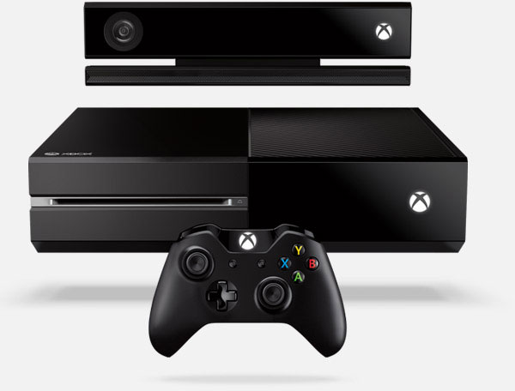


AN ALL-IN-ONE PARTNERSHIP
PARTNERSHIP OBJECTIVES:
CREATE DESIRE AND GENERATE AWARENESS FOR THE LAUNCH OF XBOX ONE
GROW PERCEPTION THAT THE XBOX ONE IS THE PREMIUM GAMING AND ENTERTAINMENT BRAND
ESTABLISH XBOX ONE AS THE LEADER IN ENTERTAINMENT AND GAMING IN THE LIVING ROOM

Slide 3

THE CREATIVE SOLUTION
Leveraging Comedy Central’s hit show, Key & Peele, we amplified the buzz and excitement around Xbox One by demonstrating its all-in-one gaming and entertainment capabilities.
Though a custom sketch series with K&P’s internet fan-favorite characters, Mike and Vandaveon, plus a series of “network takeovers,” Comedy Central seamlessly integrated the Xbox One console and showcased its revolutionary functionality.

Slide 4
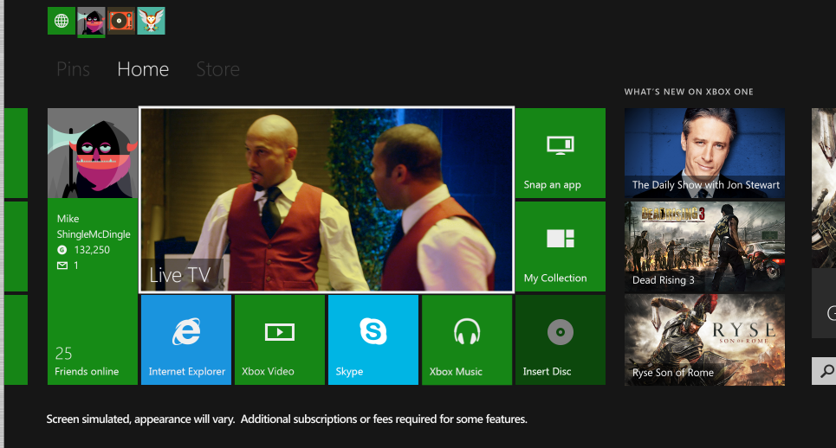
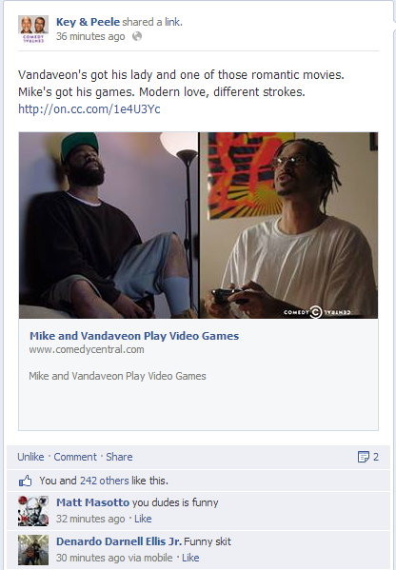
THE ROLL OUT
2 PRONGS.
2 GUYS.
1 EPIC PRIMETIME TAKEOVER.
1
2
NETWORK PROMOS
XBOX ONE TOOK OVER PRIMETIME PROGRAMMING PROMOS, LEVERAGING CHANNEL TUNE-INS TO DEMONSTRATE XBOX ONE CAPABILITIES
CUSTOM CONTENT WITH KEY & PEELE
WEB-SERIES INCLUDING BRANDED / INTEGRATED VIGNETTES RUNNING ON DIGITAL AND ON-AIR
PRONG
PRONG

Slide 5
1
NETWORK
PROMOS
PRONG

Slide 6
NETWORK PROMOS
    FOR THE FIRST TIME EVER, XBOX ONE TOOK OVER 2 HOURS of Comedy Central primetime programming on 11/20 and 11/27 with custom promos to channel tune-ins, all highlighting key Xbox One functionality and command capabilities.
  ON-AIR ELEMENTS INCLUDED:
  :15 second custom promo advancer leading in to network Programming
  In-show custom animated lower thirds
  :05 custom bumpers with “brought to you by Xbox One” messaging
Notes:
BB → http://portal/sites/adsales/entertainment/Lists/Video%20List/Custom_DispForm.aspx?List=722b807c-1e4c-4287-aa1f-35409c6dce7e&ID=1303&Source=http://portal/sites/adsales/entertainment/Pages/VideoSearchPage.aspx

Slide 7
PROGRAMMING SNAPSHOT
KEY & PEELE ON 11/20 AND 11/27

Slide 8
PROMO ADVANCER
Notes:
South Park →http://portal/sites/adsales/entertainment/Lists/Video%20List/Custom_DispForm.aspx?List=722b807c-1e4c-4287-aa1f-35409c6dce7e&ID=1303&Source=http://portal/sites/adsales/entertainment/Pages/VideoSearchPage.aspx
K&P → http://portal/sites/adsales/entertainment/Lists/Video%20List/Custom_DispForm.aspx?List=722b807c-1e4c-4287-aa1f-35409c6dce7e&ID=1303&Source=http://portal/sites/adsales/entertainment/Pages/VideoSearchPage.aspx

Slide 9
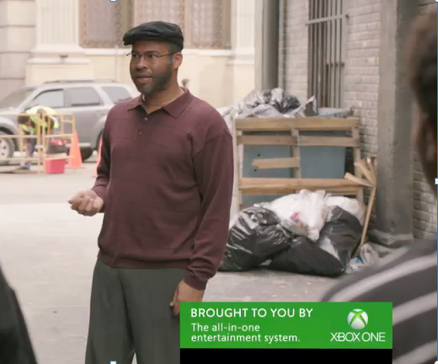
IN-SHOW LOWER THIRDS
Notes:
K&P → http://portal/sites/adsales/entertainment/Lists/Video%20List/Custom_DispForm.aspx?List=722b807c-1e4c-4287-aa1f-35409c6dce7e&ID=1303&Source=http://portal/sites/adsales/entertainment/Pages/VideoSearchPage.aspx
SP / K&P → http://portal/sites/adsales/entertainment/Lists/Video%20List/Custom_DispForm.aspx?List=722b807c-1e4c-4287-aa1f-35409c6dce7e&ID=1303&Source=http://portal/sites/adsales/entertainment/Pages/VideoSearchPage.aspx
SP & SP → http://portal/sites/adsales/entertainment/Lists/Video%20List/Custom_DispForm.aspx?List=722b807c-1e4c-4287-aa1f-35409c6dce7e&ID=1303&Source=http://portal/sites/adsales/entertainment/Pages/VideoSearchPage.aspx

Slide 10
2
CUSTOM
CONTENT
PRONG

Slide 11
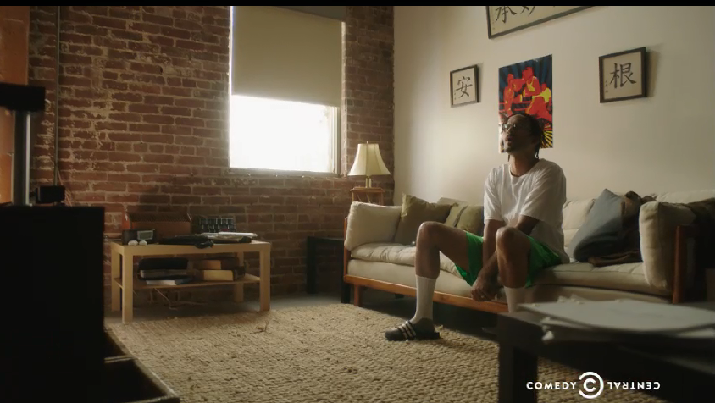
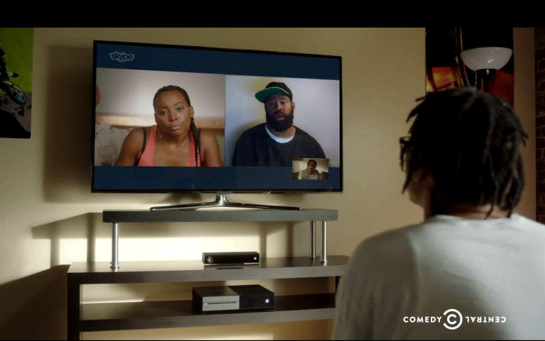
PRONG 2: CUSTOM CONTENT
    Comedy Central and Xbox One partnered to create a custom sketch series, written by and starring Keegan-Michael Key & Jordan Peele. All content integrated the Xbox One and showcased a variety of product features.
DELIVERABLES OVERVIEW:
ON-AIR:
Flight: 11/20 and 11/27
Custom Sketch Series: 3 x :30 integrated vignettes during the 11/20 (premiere) and 11/27 (encore) episodes of Key & Peele
DIGITAL:
Flight: 11/20 – 12/15
Custom K&P sketch content featured within K&P Show Page with fixed Xbox One media, launching after on-air premiere
ComedyCentral.com Homepage Roadblocks (11/20 & 11/22)
Video Pre-Roll Targeted to CC/Key & Peele Content
Social Promotion: K&P and Comedy Central editorial social promotion during shoot date and 2-week linear flight (CTA: watch extended clip)
Notes:
Vignette 1 → http://portal/sites/adsales/entertainment/Lists/Video%20List/Custom_DispForm.aspx?List=722b807c-1e4c-4287-aa1f-35409c6dce7e&ID=1303&Source=http://portal/sites/adsales/entertainment/Pages/VideoSearchPage.aspx
Vignette 2 → http://portal/sites/adsales/entertainment/Lists/Video%20List/Custom_DispForm.aspx?List=722b807c-1e4c-4287-aa1f-35409c6dce7e&ID=1303&Source=http://portal/sites/adsales/entertainment/Pages/VideoSearchPage.aspx
Vignette 3 → http://portal/sites/adsales/entertainment/Lists/Video%20List/Custom_DispForm.aspx?List=722b807c-1e4c-4287-aa1f-35409c6dce7e&ID=1303&Source=http://portal/sites/adsales/entertainment/Pages/VideoSearchPage.aspx

Slide 12

COMEDY CENTRAL DELIVERS
XBOX ONE’S PRIMETIME TAKEOVER ON 11/20 AND 11/27 REACHED OVER 16.6 MILLION VIEWERS.
Each viewer was exposed to Xbox One’s message an average of 3.3 times
P18-49 → 10MM VIEWERS
P18-34 → 6.3MM VIEWERS
M18-49 → 6.3MM VIEWERS
M18-34 → 4MM VIEWERS
Source: NMR C3 data. MSFT campaign = Xbox Video Game System, 11/14 through 11/27. Reach based on 1 min qualifier.

Slide 13
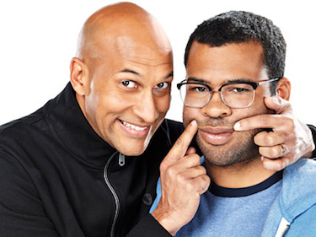
ON-AIR PRIMETIME TAKEOVER
11/20 (PREMIERE) RESEARCH HIGHLIGHTS
KEY & PEELE (PREMIERE): 10:30P – 11:00P
Ranked as the #5 cable program in Prime with M18-49
M18-49 Nat Rtg: 1.20 (up +5% vs previous week)
P18-49 Nat Rtg: .83 (up +5% vs previous week)
Nearly 10M social mentions
SOUTH PARK (PREMIERE): 10:00P – 10:30P
Ranked as the #1 cable program for the day with M18-49 & #2 with P18-49
M18-49 Nat Rtg: 2.19 (+9% vs season to date average)
P18-49 Nat Rtg: 1.47 (+7% vs season to date average)
#3 most talked about cable show in Prime (over 35M social mentions)
SOUTH PARK ENCORES: 9:00P – 10:00P
Ranked as the #4 cable program for the day with M18-49 & #6 with P18-49
M18-49 Nat Rtg: .87 (+7% vs prior four weeks)
P18-49 Nat Rtg: .64 (+20% vs prior four weeks)
Source: NMR Live+SD data. Nat Rtgs. Ranks based on impressions, Total day =6a-6a, Prime = 6p-11p. Prior 4 weeks for 11/20/13=10/23/13-11/13/13, Wed 9p-10p. Social mentions based on TrendrrTV.

Slide 14

VIEWERS TUNED IN
THE XBOX ONE PRIMETIME TAKEOVER WAS WELL-RECEIVED AMONG COMEDY CENTRAL VIEWERS.
IN FACT, THE THREE CUSTOM VIGNETTES FEATURING XBOX ONE HAD A
10% HIGHER AUDIENCE RETENTION RATE
THAN COMPETITIVE COMMERCIALS ON COMEDY CENTRAL DURING THIS TIME PERIOD.
Source: Nielsen Npower, 10/18/13-11/27/13; only includes telecasts across Microsoft's Xbox One campaign. Reach based on 1+ minute qualifier.
Comedy 11/20, 9-11p and 11/27, 10:30-11p

Slide 15

YOU REACHED GAMERS
COMEDY CENTRAL VIEWERS SPEND HEAVILY ON THEIR GAMING.
M18-49 Viewers who tuned in to the Xbox Primetime Takeover are…
More than three times as likely to be heavy video game users (364 index)
More than three times as likely as the average US adult to have spent $400+ on a video game system (351 index)
More than twice as likely to have spent $100+ on video games in the past year (225 index)
Source: Nielsen Npower, 10/18/13-11/27/13; only includes telecasts across Microsoft's Xbox One campaign. Reach based on 1+ minute qualifier.
Comedy 11/20, 9-11p and 11/27, 10:30-11p

Slide 16
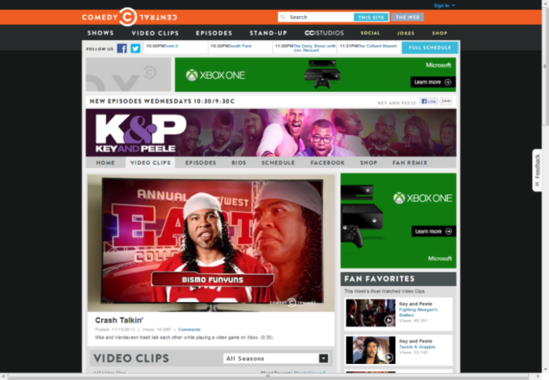
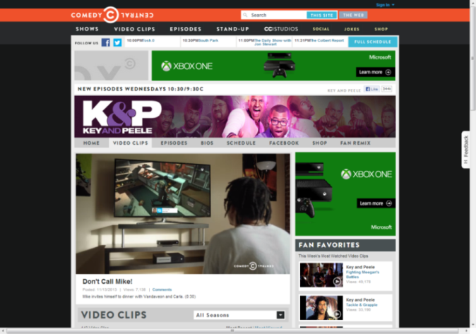
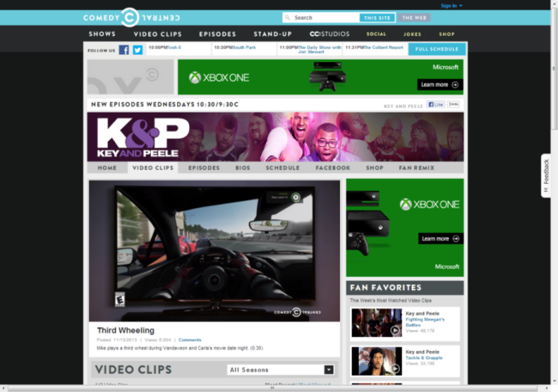
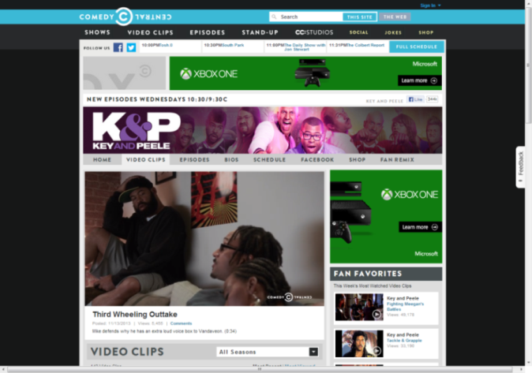
CUSTOM SKETCH CONTENT
FEATURED ON K&P SHOW PAGE FROM 11/20-12/15
Following the Xbox One on-air Primetime takeover on 11/20, all of the custom sketches were posted on the K&P show page for our fans to check out on demand.
More than 240M Streams
Notes:
Playlist: http://www.comedycentral.com/video-collections/ndlhjc/key-and-peele-mike-and-vandaveon-play-video-games/6tszww
http://www.comedycentral.com/video-clips/6tszww/crash-talkin- 73M streams
http://www.comedycentral.com/video-clips/qodwfb/don-t-call-mike- 60M streams
http://www.comedycentral.com/video-clips/d0ifn9/third-wheeling 51M streams
http://www.comedycentral.com/video-clips/x0x2j3/third-wheeling-outtake 56M streams

Slide 17
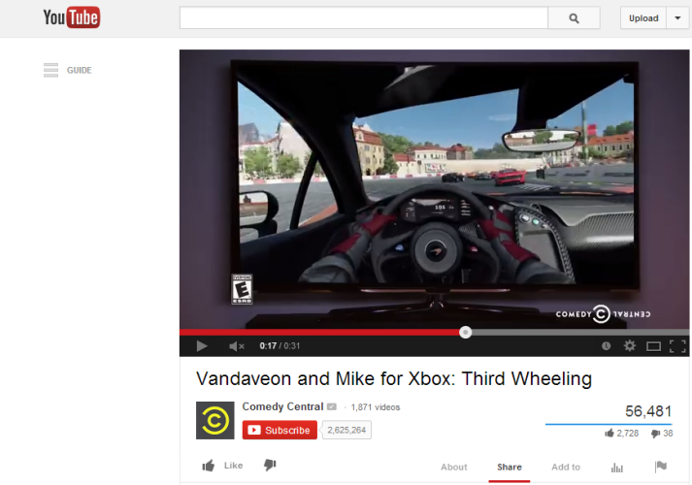
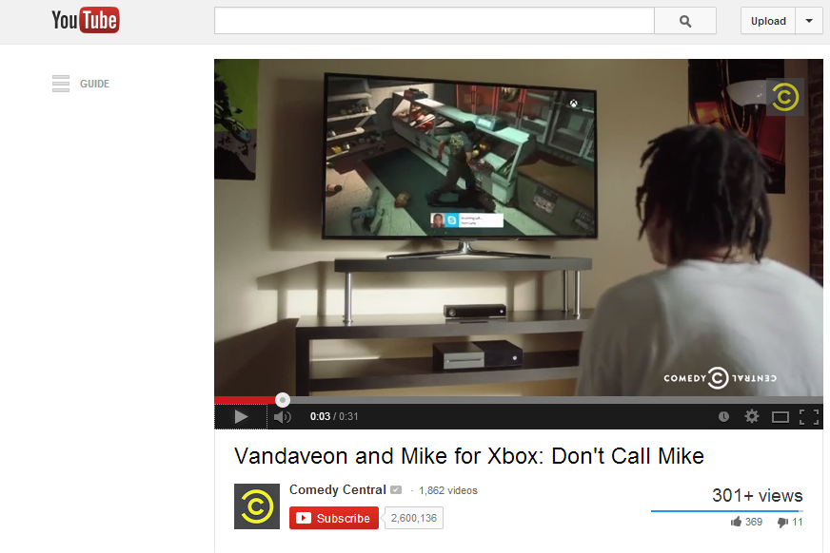
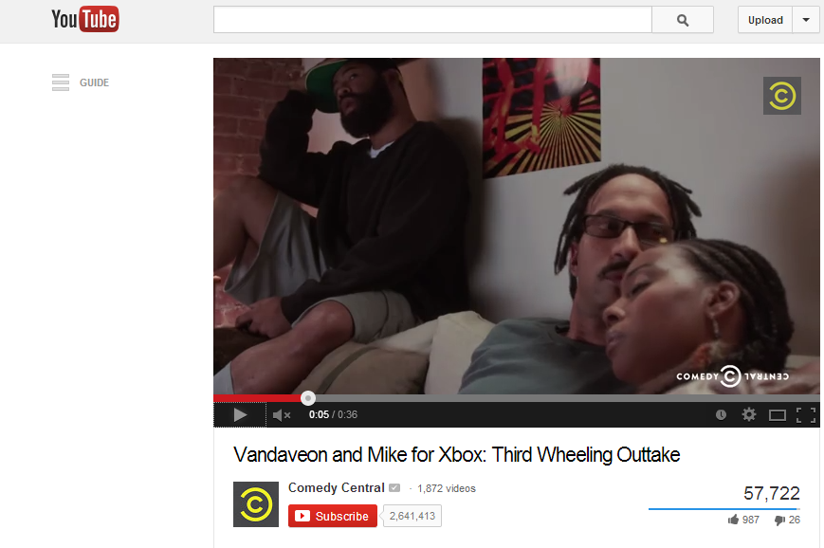
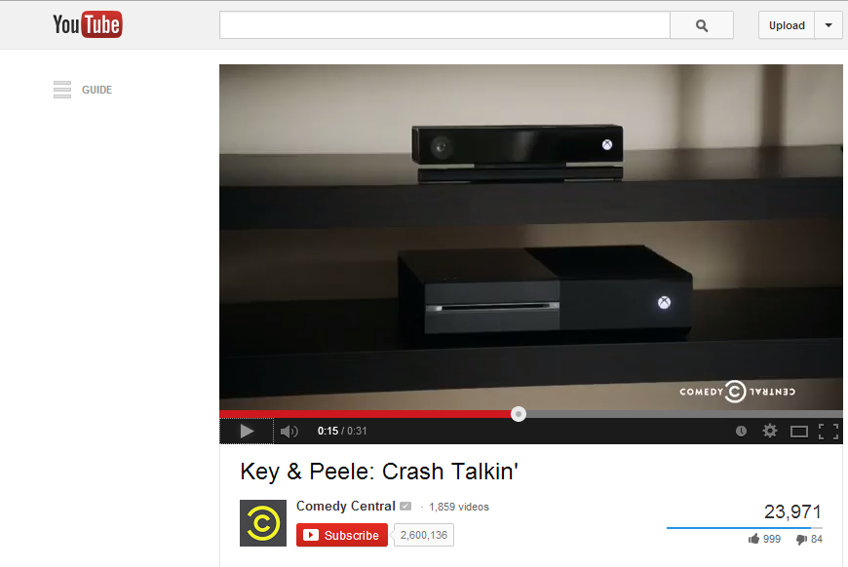
CUSTOM SKETCH CONTENT
POSTED TO YOUTUBE TO EXTEND REACH
In order to reach K&P fans on every digital platform, the custom sketches were also posted to the K&P YouTube channel.
More than 422M Streams
Notes:
Crash Talkin http://www.youtube.com/watch?v=PwjYLFGcEks – 135M streams
Don’t Call Mike https://www.youtube.com/watch?v=LCXmPCz_104 – 101M streams
Third Wheelin’ http://www.youtube.com/watch?v=gZ6_x2GEAD4 – 106M streams
Third Wheelin’ Outtake http://www.youtube.com/watch?v=CTlhxzKrnxE – 80M streams

Slide 18

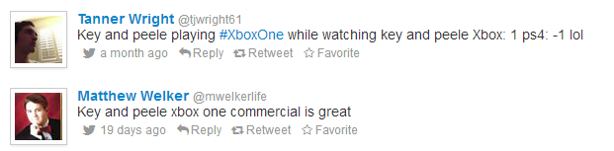


FANS RESPONDED
CUSTOM SKETCH CONTENT RESONATES WITH SOCIAL FANS

Slide 19
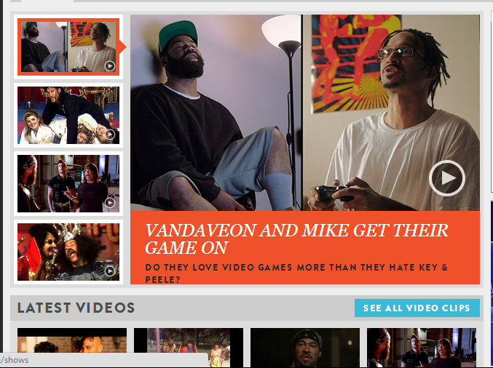
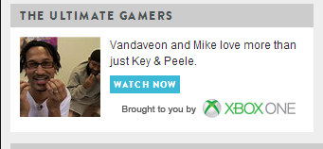
GETTING THE WORD OUT
    To ensure all comedy central fans knew to check out the custom Key & Peele content, we promoted them from the Key & Peele homepage within the main carrousel and on the Comedy Central homepage from a custom promo tout
CC.com Homepage
Promo Tout Placement with OVER 1.13MM PAGE VIEWS
Key and Peele Homepage Carousel Placement
Source: Omniture SiteCatalyst, November-December 2013

Slide 20


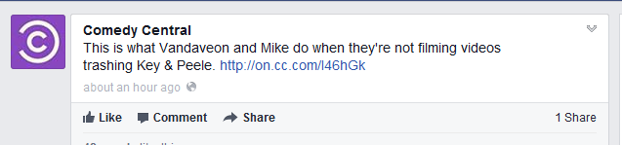

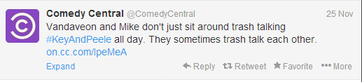
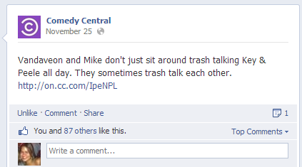

CC OVERDELIVERS ON SOCIAL
Generated Nearly 1.2MM Earned Media Impressions
COMEDY CENTRAL POSTED ON FACEBOOK AND TWITTER IN ORDER TO SPREAD THE WORD ABOUT OUR CUSTOM SKETCH CONTENT TO FANS.
IN SPIRIT OF PARTNERSHIP, COMEDY CENTRAL PUSHED OUT TWO “BONUS” POSTS ON 11/25 (ONE ON FACEBOOK, ONE ON TWITTER) SINCE XBOX WAS TRENDING ONLINE.
Notes:
https://www.facebook.com/ComedyCentral/posts/10152018642634030
https://www.facebook.com/ComedyCentral/posts/10152026929039030
https://twitter.com/ComedyCentral/status/406593198924902400
https://twitter.com/ComedyCentral/status/405126528565932032

Slide 21

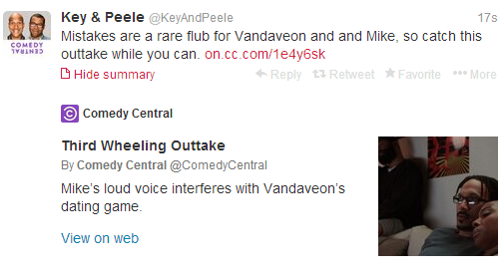
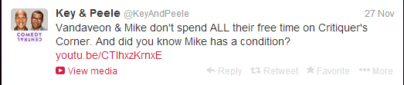
K&P OVERDELIVERS ON SOCIAL
KEY & PEELE ALSO POSTED ON FACEBOOK AND TWITTER TO SPREAD THE WORD ABOUT OUR CUSTOM SKETCH CONTENT TO FANS.
Generated Nearly 150M Earned Media Impressions
TWO “BONUS” POSTS FROM K&P’S TWITTER HANDLE
Notes:
https://www.facebook.com/KeyAndPeele/posts/573827935999477
https://twitter.com/KeyAndPeele/status/403613277906681856
https://twitter.com/KeyAndPeele/status/405774040658632705
https://twitter.com/KeyAndPeele/status/405804970840039424

Slide 22

AWARENESS AMPLIFIED
CRM EMAIL:
LAUNCHED ON NOVEMBER 21, 2013
DISTRIBUTED TO OVER 1.2MM INDIVIDUALS WHO ARE INTERESTED IN XBOX AND VIDEO GAME RELATED CONTENT
EARNED MEDIA TO EXPAND REACH OF CONTENT

Slide 23
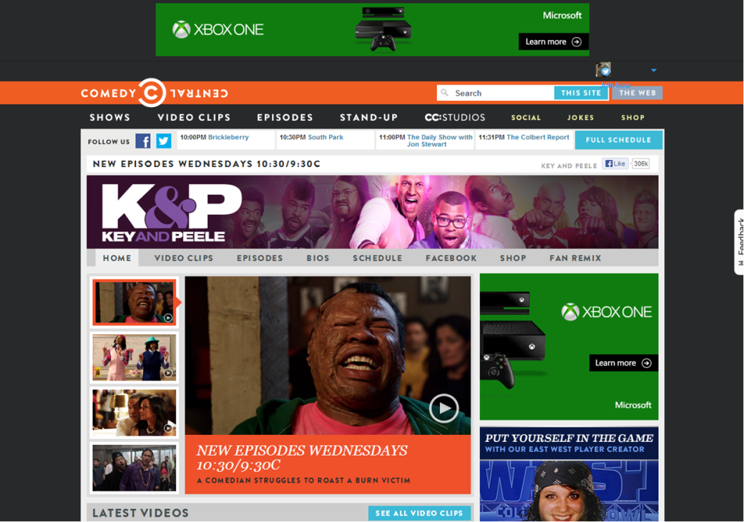
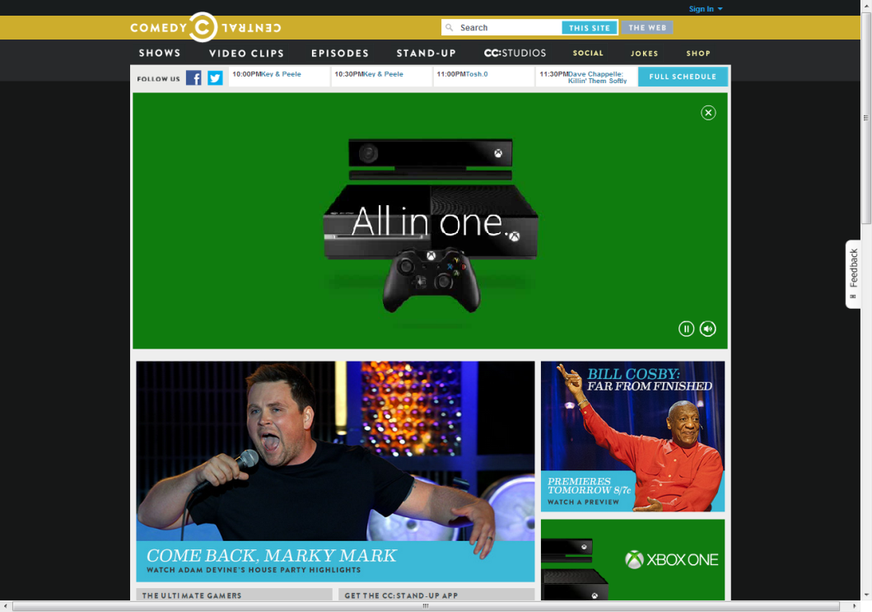
HIGH-IMPACT MEDIA PLACEMENT
CC & K&P HOMEPAGE ROADBLOCKS
To make a big splash in the digital sphere, Xbox One took over VMNE digital platforms with high impact media placements and homepage roadblocks.
Garnered nearly 500M impressions
Source: Omniture SiteCatalyst, November-December 2013

Slide 24


K&P KEEPS ON GROWING
65% GROWTH in Key & Peele Facebook fans over the past 5 months, with current total of over 400M fans
Key & Peele had 78.24M tweets/social buzz surrounding the show in 3Q 2013, UP 502% from Q2 2013
23% GROWTH IN KEY & PEELE TWITTER FANS over past 3 months, with current total of over 98M followers
Average time spent per visitor on clips on the Key & Peele hub on CC.com clips is 5.9 minutes, UP 34% year over year
Source: Facebook Analytics, 12/13/13 vs. 7/13/13; (Source: Social Guide, 3Q 2013 vs. 2Q 2013); (Source: TwitterCounter, 12/15/13 vs. 9/15/13); Omniture SiteCatalyst, 9/1/13—12/15/13 vs. 9/1/12—12/15/12

Slide 25

IN THE END . . .
XBOX ONE: Leveraged Comedy Central talent and programming platforms to drive awareness around the launch of Xbox One and highlight priority capabilities
COMEDY CENTRAL: Provided fans with a uniquely custom experience during a Primetime takeover and leveraged one of Comedy Central’s most popular programs, Key & Peele
MIKE & VANDAVEON: “XBOX ONE FOR LIFE…OH, AND CARLA TOO.”

Slide 26
APPENDIX

Slide 27

K&P SHOW PAGE ROADBLOCK
ON 10/28

Slide 28
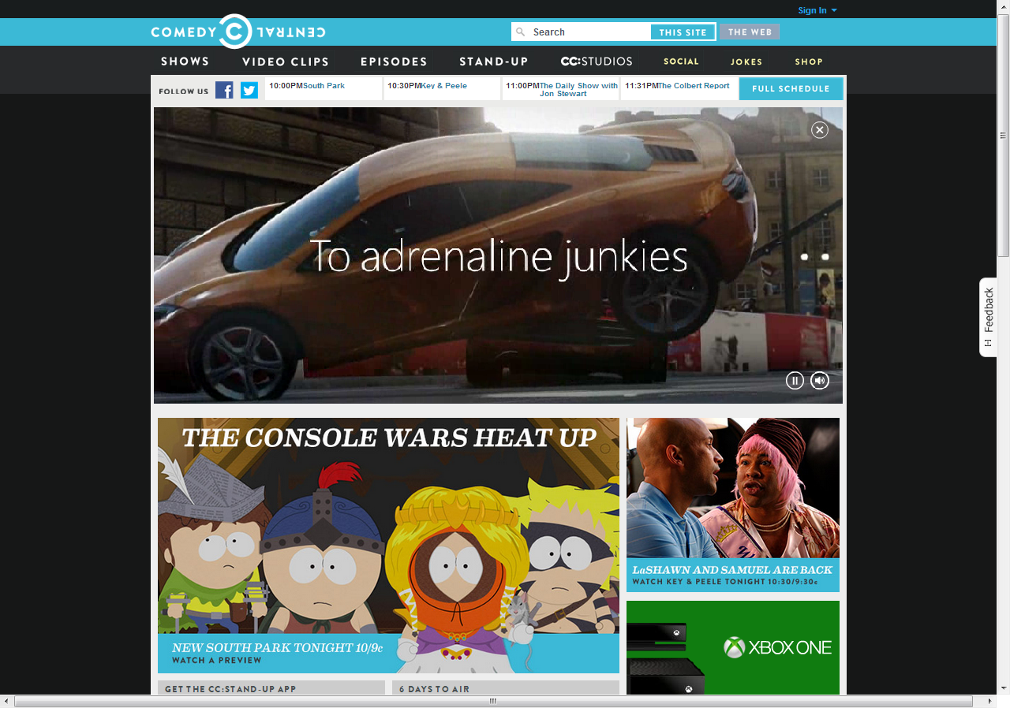
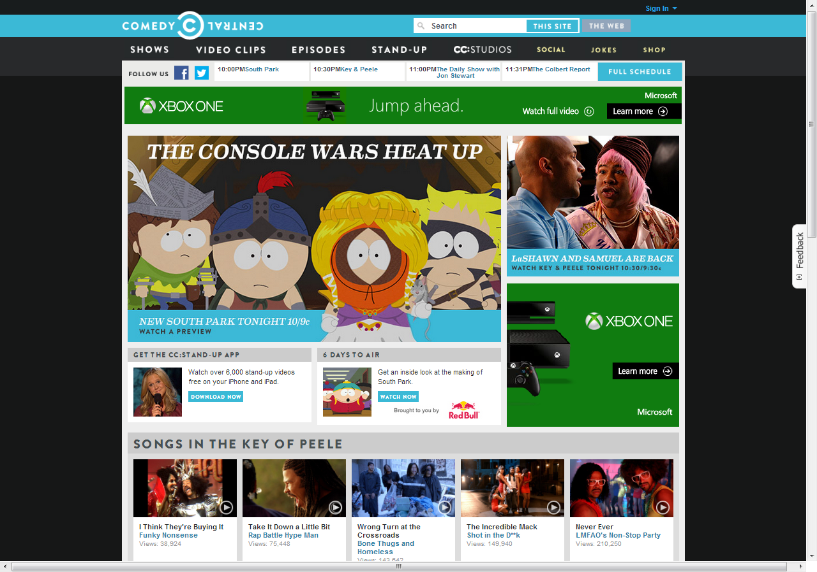
CC.COM HOMEPAGE ROADBLOCK
ON 11/20

Slide 29
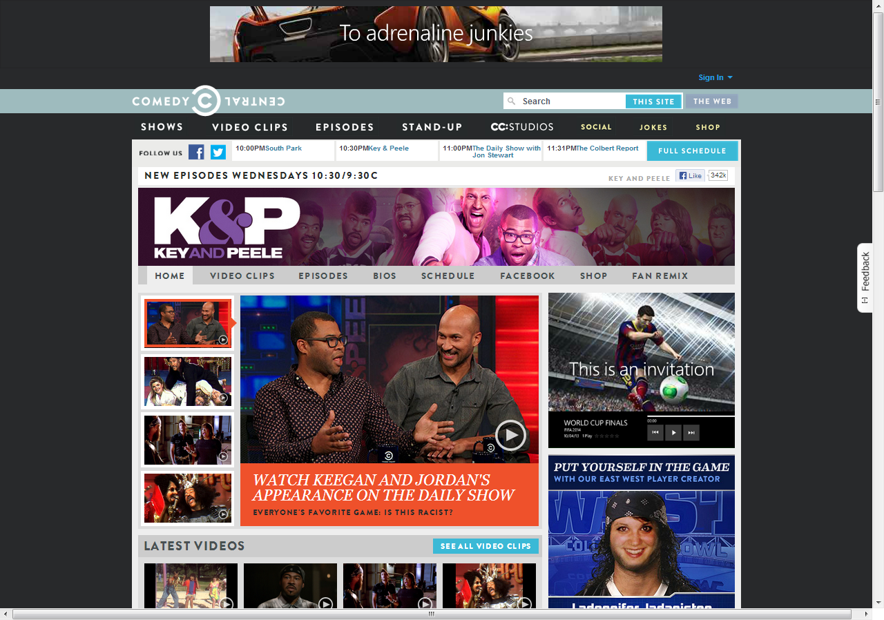
K&P SHOW PAGE ROADBLOCK
ON 11/20

Slide 30

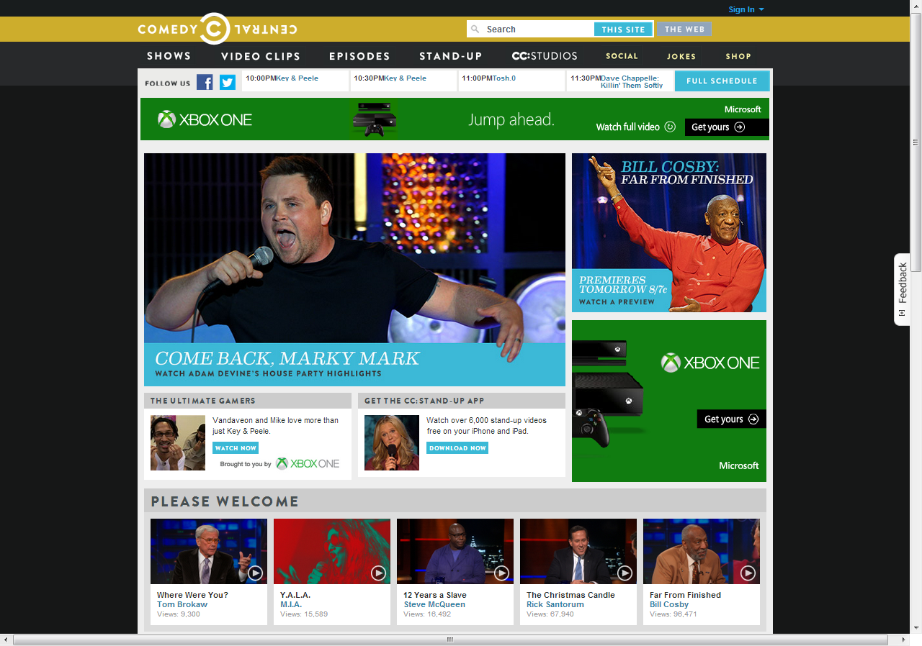
CC.COM HOMEPAGE ROADBLOCK
ON 11/22

Slide 31
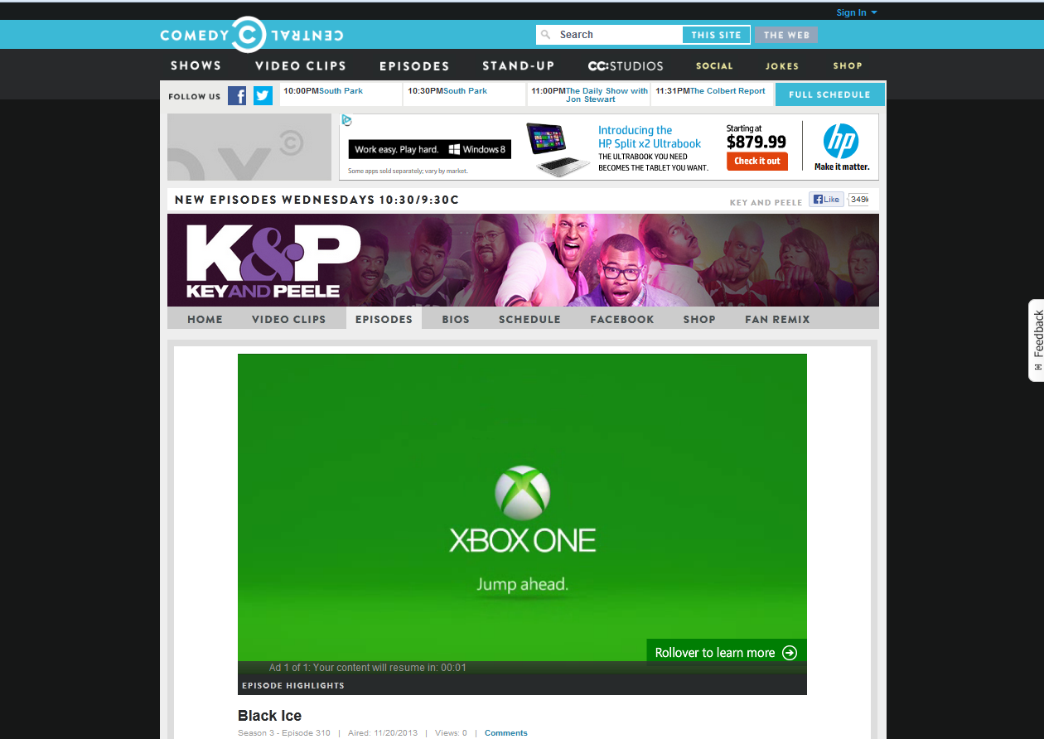
VIDEO PRE-ROLL
TARGETED TO CC AND K&P CONTENT ON 11/22

Slide 32
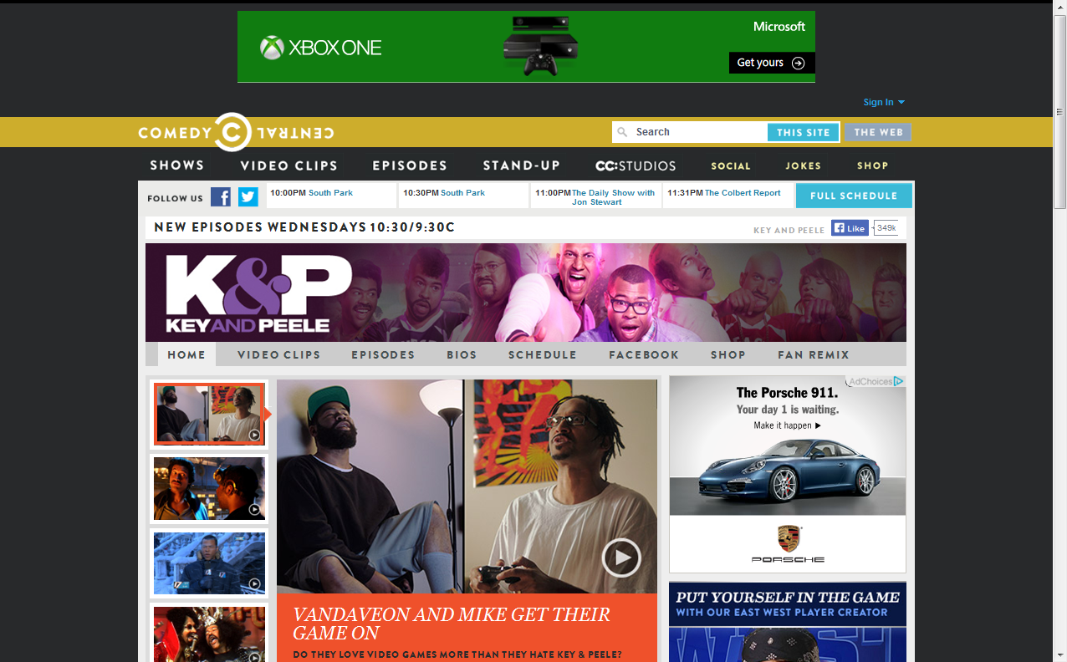
728x90 BANNER
TARGETED TO CC AND K&P CONTENT ON 11/22

Slide 33
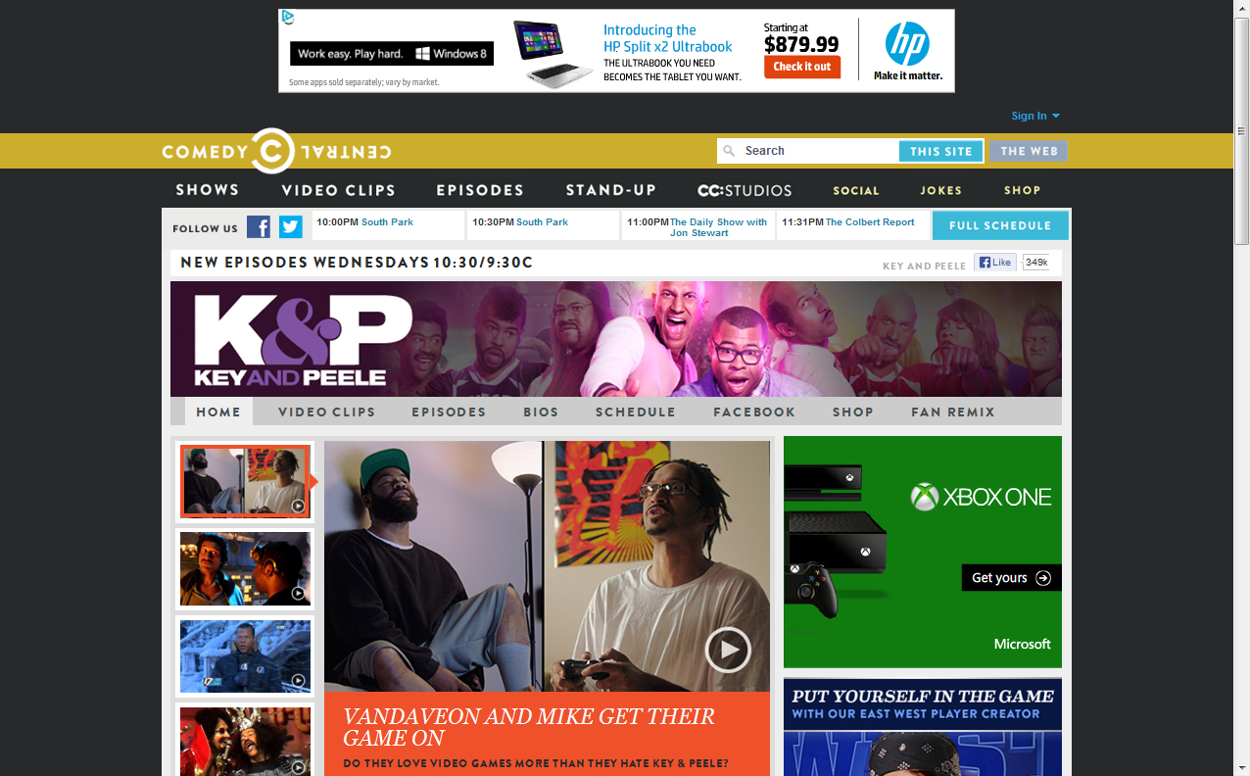
300x250 BANNER
TARGETED TO CC AND K&P CONTENT ON 11/22

Slide 34




CUSTOM CONTENT ON THE K&P SHOW PAGE WITH FIXED MEDIA
Notes:
Playlist: http://www.comedycentral.com/video-collections/ndlhjc/key-and-peele-mike-and-vandaveon-play-video-games/6tszww
http://www.comedycentral.com/video-clips/6tszww/crash-talkin-
http://www.comedycentral.com/video-clips/qodwfb/don-t-call-mike-
http://www.comedycentral.com/video-clips/d0ifn9/third-wheeling
http://www.comedycentral.com/video-clips/x0x2j3/third-wheeling-outtake

Slide 35
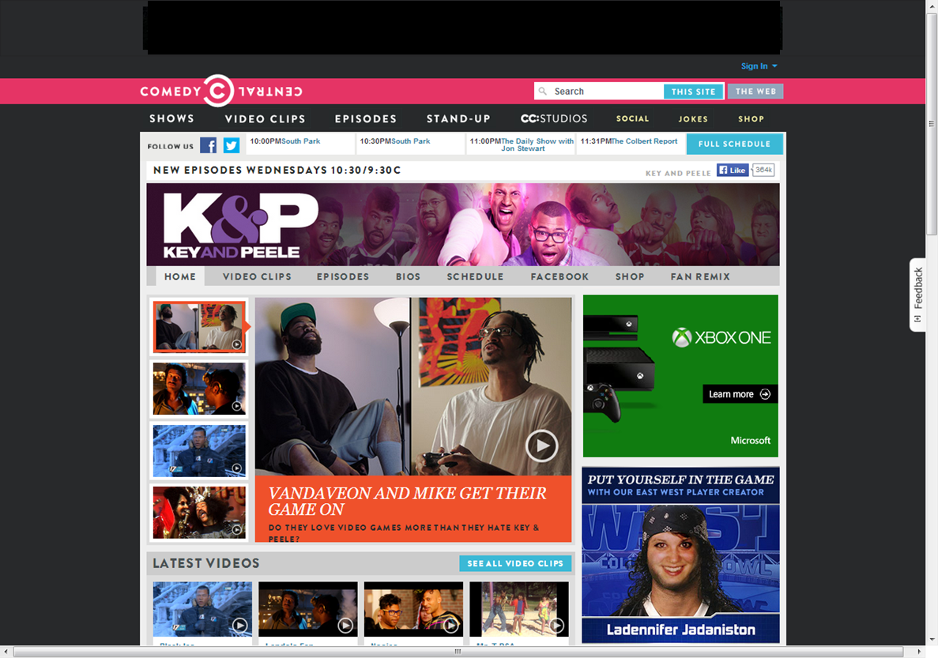
K&P SHOW PAGE EDITORIAL PROMOTION

Slide 36
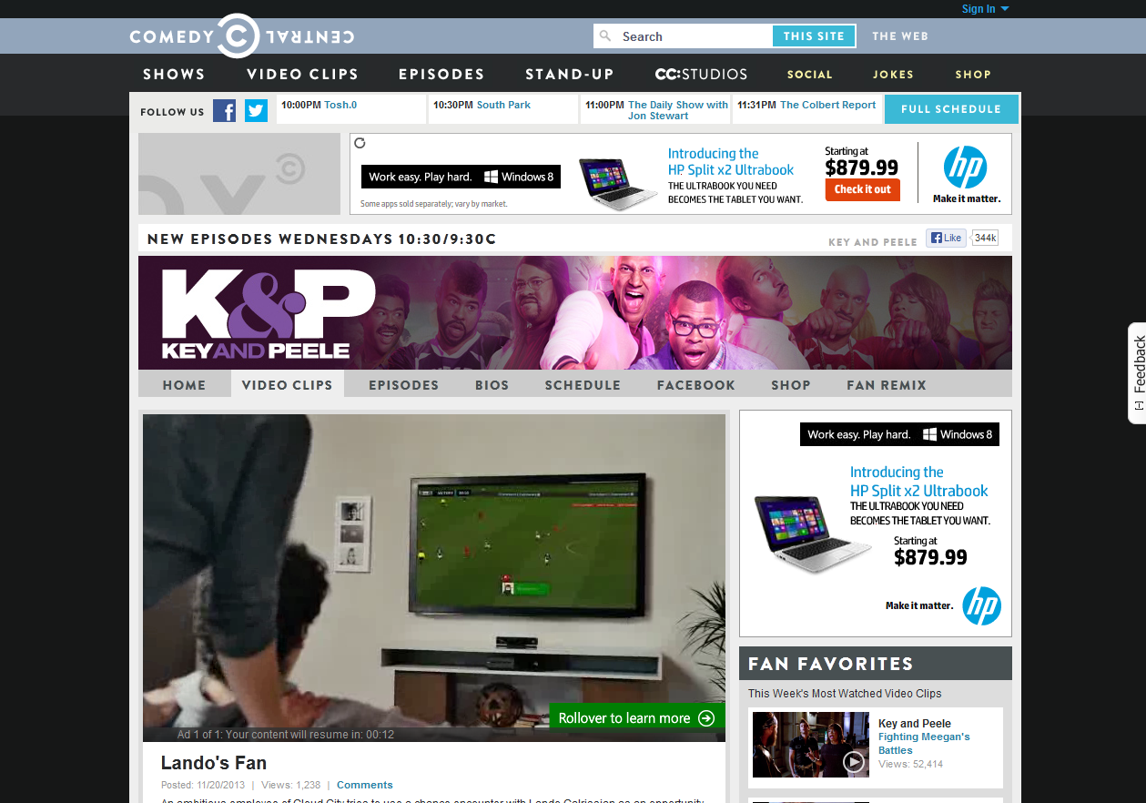
VIDEO PRE-ROLL
TARGETED TO CC AND K&P CONTENT ON 11/22

Slide 37
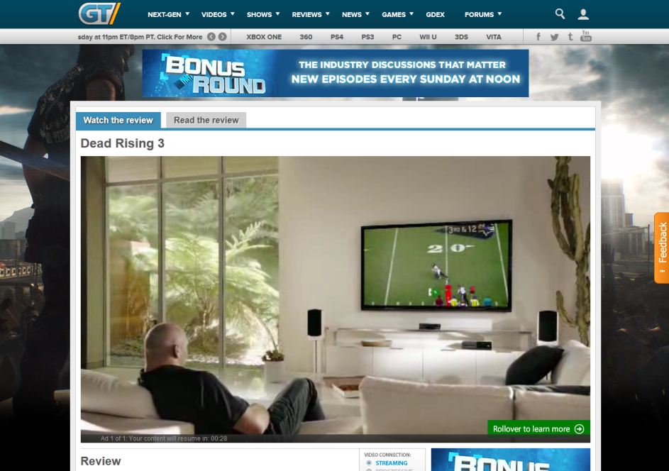
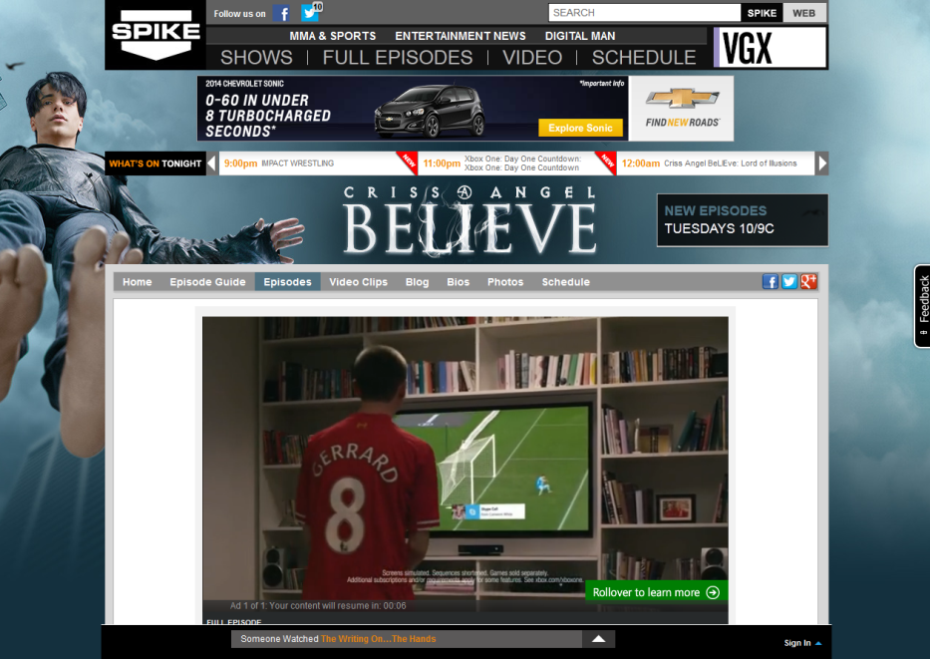
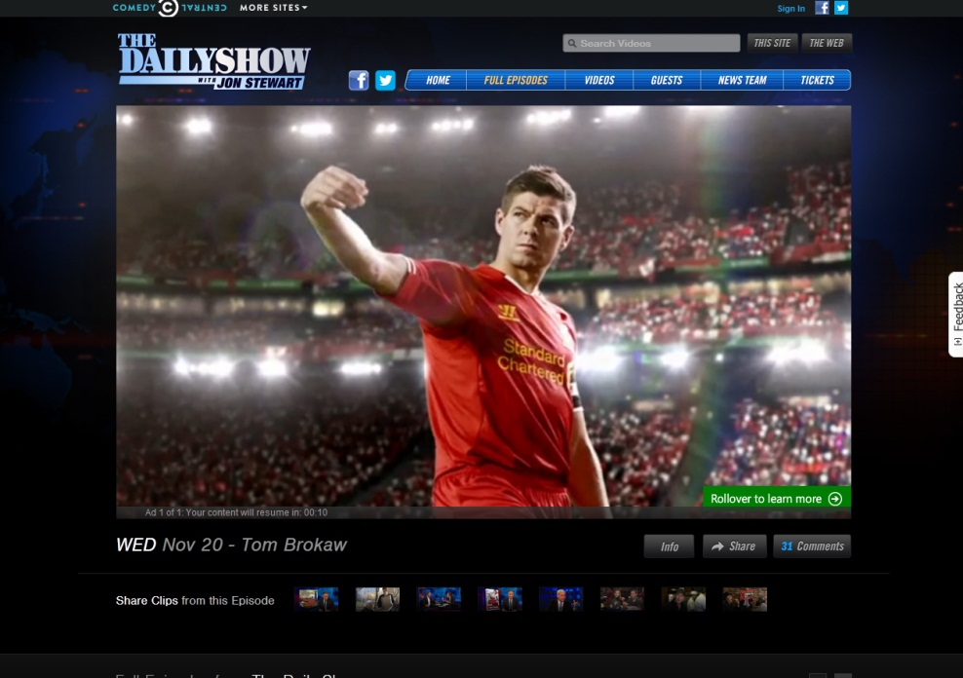
VIDEO PRE-ROLL
ACROSS THE VIACOM MEDIA NETWORKS ENTERTAINMENT GROUP

